Slide 1

D I S C O V E R A N E W L E V E L O F M A R K E T I N G
E X C E L L E N C E
PRESENTED BY (NAME)
YOUR LUXURY REAL ESTATE EXPERT

Slide 2
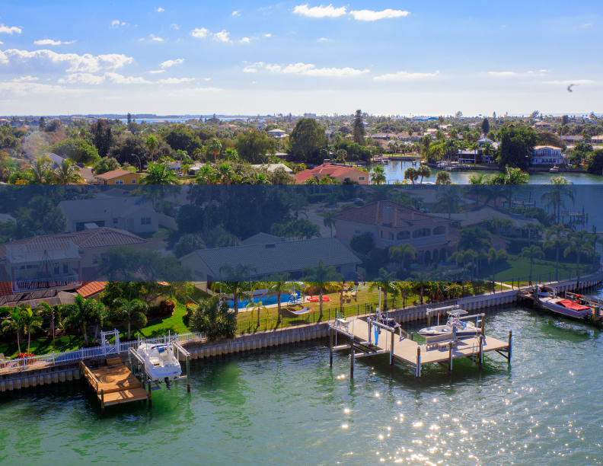
A P R E V I E W O F
(NAME)

Slide 3
YOUR REAL ESTATE EXPERT
The most important decision you can make when buying or selling a home is to find the right REALTOR®. You need someone with experience and someone who is dedicated to looking out for YOUR best interests.
(Name) is an energetic, passionate, and driven individual who thrives on going the extra mile. (Name) brings this passion and drive to every client relationship (she) develops. (She) is a top producer for RE/MAX Metro, focusing on luxury properties and their communities.
(Name) attributes (her) success in real estate to (her) ability to understand the individual motivations of each client and (her) desire to forge lasting relationships with them. (She) measures (her) achievements by the value (she’s) added and the difference (she’s) made.
As a Certified Luxury Home Marketing Specialist, (Name) is committed to staying on top of the latest trends in the local market. (She) also focuses on areas of specific concern for (her) clients, including upcoming local events and happenings and any news impacting the health and well being of the community as a whole. (Name) loves being active and inspiring others to live well and be healthy.

Slide 4


A G E N T‘S N A M E
REALTOR® RE/MAX METRO
727.555.5555
EMAIL@remaxmetro.com

Slide 5

FULL-SERVICE LUXURY REAL ESTATE
When you hire (Name), (she) will become your home’s
^{MARKETING MANAGER}
Showcasing your property with the finest marketing
Developing and implementing a customized marketing plan
Determining the best price in line with market forces
Communicating regularly, so you stay informed
^{LIAISON MANAGER}
Introducing new buyers to your property
Pre-qualifying the buyers to avoid time wasters
Providing you with timely updates on viewings and feedback

Slide 6
FULL-SERVICE LUXURY REAL ESTATE
^{NEGOTIATOR}
Presenting and negotiating with potential buyers on your behalf
Advising you on the merits of each offer
Always keeping your best interests as first priority
^{CLOSING MANAGER}
Providing information to the buyer in a timely manner
Only accepting certified bank drafts
Liaising with your lawyer/notary and delivering the necessary documentation
Facilitating answers, resolving any issues during the closing process, and ensuring the process is completed seamlessly

Slide 7
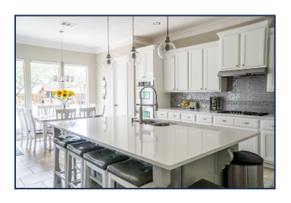
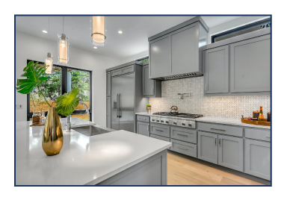
FULL-SERVICE LUXURY REAL ESTATE
^{CONCIERGE}
Providing you with access to experts, including:
  ^{Legal advisors}
  ^{Insurance experts}
  ^{Builders}
  ^{Landscapers}
  ^{Interior designers}
  ^{Rental experts}
  ^{Home stagers}
  ^{Painters and handymen}
  ^{Home inspectors}
  ^{Moving services}

Slide 8
DEDICATION AND COMMITMENT
JUST ASK MY CLIENTS:
Jane Smith has represented us in numerous real estate transactions. She always listens very closely to our needs and quickly understands our priorities. Her knowledge and experience of selling and buying homes in the luxury market are priceless, and she never tires of exploring new avenues to gain maximum exposure for our homes at all times.
^{GEORGE O.}

Slide 9
DEDICATION AND COMMITMENT
JUST ASK MY CLIENTS:
Jane is by far the best Realtor we have worked with. She pays attention to every detail, is very professional, and will walk you through the entire process. Jane helped us thoroughly and never pressured us on any level. I have recommended her to a few friends and family members,
^{and will continue to do so.}
^{JOHN & IRENE R.}

Slide 10
DEDICATION AND COMMITMENT
JUST ASK MY CLIENTS:
Jane Smith is simply professional. Her hard work, patience, and knowledge are second to none. I felt that she truly cared about what best suited my needs rather than just making a sale. She took the time to explain and educate me on things that I just would not have taken into consideration, but are the important differences in selling a home in the luxury market. I had a great experience working with Jane and highly recommend her.
^{JEANETTE S.}

Slide 11

RE/MAX Metro is an established and trusted full-service residential and commercial property management real estate brokerage serving the Tampa Bay/St. Petersburg area. RE/MAX Metro is supported by a trusted name for over 45 years with global exposure to over 110 countries. RE/MAX Metro is Southern Pinellas’ #1 brokerage.
Over the last 15 years, our 165+ local associates and over 119,000 global associates have successfully helped clients from around the world find that perfect home, investment property, or second home. With three Tampa locations, you can trust that our agents will guide you through the home buying, selling, or investing process, backed by our proven approach from start to finish.

Slide 12
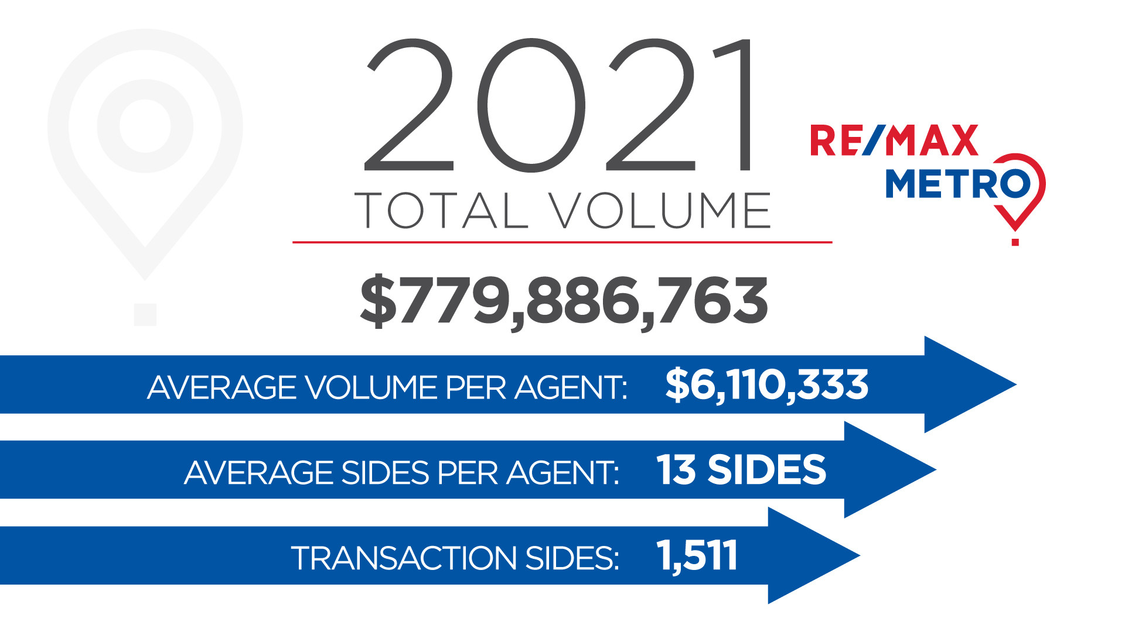
OUR NUMBERS SPEAK
FOR THEMSELVES

Slide 13



COMMUNITY SUPPORT
^{CHILDREN’S MIRACLE NETWORK}
RE/MAX agents have raised more than $147 million for the charity’s 170 member hospitals in the U.S. and Canada since 1992
Donations help fund pediatric medical equipment and treatments, healthcare services, and charitable care
For some agents, these donations are very personal, helping kids in their own families and neighborhoods
^{SUSAN G. KOMEN® FOR THE CURE}
RE/MAX Affiliates have proudly supported Susan G. Komen® since 2002
Through the Home for the Cure program and past sponsorship of the Komen Race for the Cure Series, RE/MAX agents have contributed more than $7 million to the fight against breast cancer

Slide 14
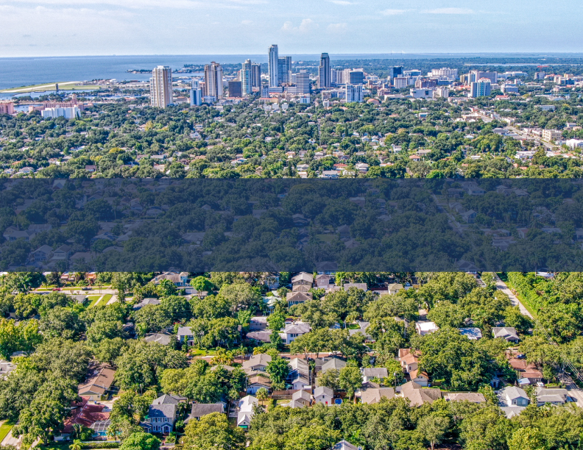

T H E P O W E R O F
RE/MAX

Slide 15
RE/MAX LEADS THE INDUSTRY
MARKET SHARE AND AGENT PRODUCTIVITY
RE/MAX associates average more sales than any other real estate agents in the world.
^{BRAND NAME AWARENESS}
RE/MAX is the most recognized brand in real estate. Their national advertising campaign positions the RE/MAX name in front of millions of buyers and sellers all over the country and is designed to keep the brand, as well as remax.com, top-of-mind when someone decides it is time to buy or sell their home.

Slide 16


RE/MAX LEADS THE INDUSTRY
^{ADVERTISING}
In the United States, RE/MAX has the real estate industry’s strongest presence in national television advertising, helping to make the RE/MAX hot air balloon one of the most recognizable logos in the world.
WEBSITE TRAFFIC AND ONLINE SERVICES
Remax.com is the most highly visited real estate franchise website in the world, attracting over 77 million visitors annually who can view your home in over 43 languages.

Slide 17


RE/MAX LEADS THE INDUSTRY
^{PROFESSIONAL EDUCATION}
RE/MAX agents lead the industry in professional designations, awards, and recognition.
^{NUMBER OF COUNTRIES SERVED}
RE/MAX has a presence in over 110 countries and territories with over 130,000 agents, and numerous partner organizations around the world.

Slide 18
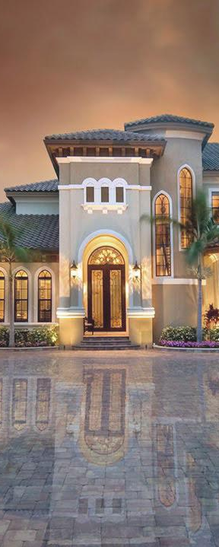





THE RE/MAX COLLECTION
Only the most exceptional homes qualify for status in The RE/MAX Collection. Whether it’s marketing real estate to a global clientele or helping you find that perfect place you’ve been dreaming of your entire life, the outstanding agents behind The RE/MAX Collection deliver outstanding results.

Slide 19
RE/MAX VS. THE INDUSTRY
15.6
15.6
TRANSACTION SIDES PER AGENT¹
9.2
7.3
7.0
6.9
6.7
6.4
6.4
6.0
5.7
5.6
5.3
4.2
RE/MAX
ERA
Coldwell Banker
Century 21
Keller Williams
Berkshire Hathaway
Better Homes & Gardens
Sotheby’s
Realty Executives
Realty ONE
Compass Group
eXp Realty
HomeSmart
TRANSACTION SIDES PER AGENT¹
15.6
U.S. TRANSACTION SIDES²
965,859
BRAND AWARENESS (UNAIDED)³
32.5%
COUNTRIES & TERRITORIES
110+
OFFICES WORLDWIDE
8,629
AGENTS WORLDWIDE
130,889
©2020 RE/MAX, LLC. Each office independently owned and operated. Data is full-year or as of year-end 2019, as applicable. Except as noted, Coldwell Banker, Century 21, ERA, Sotheby’s and Better Homes and Gardens data is as reported by Realogy Corporation on SEC 10-K, Annual Report for 2019; other competitor data is from company websites and industry reports. ¹Except as noted below, transaction sides per agent are calculated by RE/MAX based on 2020 REAL Trends 500 data, citing 2019 transaction sides for the 1,711 largest participating U.S. brokerages. Coldwell Banker includes NRT/Realogy Brokerage Group. For the following competitors, averages were reported in the 2020 T360 Real Estate Almanac’s Top 20 Residential Real Estate Franchisors based on Transaction Sides, citing 2019 transaction sides: Berkshire Hathaway HomeServices, Realty ONE Group and Realty Executives. Berkshire does not include HomeServices of America. ²Totals for Sotheby’s, Realty Executives, Realty ONE, Compass, eXp Realty and HomeSmart are for residential transactions only while totals for all other brands include commercial transactions.³MMR Strategy Group study of unaided awareness among buyers, sellers, and those planning to buy or sell; asked, when they think of real estate brands, which ones come to mind?

Slide 20
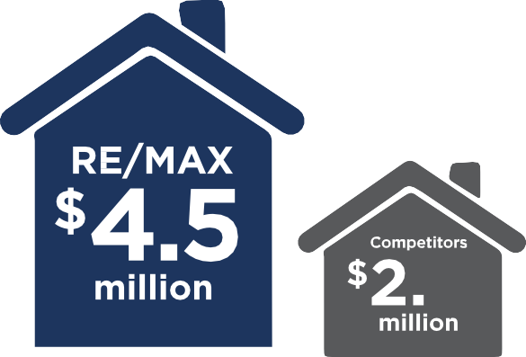



RE/MAX OUTSELLS THE COMPETITION
Double the Others
Higher Volume by Far
RE/MAX agents averaged more than twice as many transaction sides as competitors.
RE/MAX agents averaged 72% more sales volume than the average for competitors.

Slide 21
LOCAL EXPERTS
GLOBALLY CONNECTED
THE WORLDWIDE RE/MAX NETWORK
AMERICAS
Argentina
Belize
Bolivia
Brazil
Canada
Chile
Colombia
Costa Rica
Ecuador
El Salvador
Guatemala
Honduras
Mexico
Nicaragua
Panama
Paraguay
Peru
Suriname
United States
Uruguay
Venezuela
CARIBBEAN
Antigua & Barbuda
Aruba*
Bahamas
Bonaire*
British Virgin Islands*
Cayman Islands*
Curacao*
Dominican Republic
Grenada
Haiti
Jamaica
Puerto Rico*
St. Bartheleny*
St. Kitts & Nevis
St. Lucia
St. Maarten/ St. Martin*
St. Vincent/ Grenadines
Trinidad & Tobago
Turks & Caicos*
U.S. Virgin Islands*
EUROPE
Albania
Austria
Belgium
Bosnia and Herzegovina
Bulgaria
Croatia
Cyprus
Czech Republic
England*
Estonia
Finland
France
Germany
Greece
Georgia
Hungary
Iceland
Israel
Italy
Kosovo
Latvia
Lithuania
Luxembourg
Malta
Moldova
MIDDLE EAST
Egypt
Jordan
Lebanon
Oman
Saudi Arabia
United Arab Emirates
West Bank/ Palestine
ASIA /PACIFIC
Australia
China
Guam
India
Indonesia
Japan
Macau
Malaysia
Mongolia
Myanmar
New Zealand
Palau
Philippines
Singapore
South Korea
Sri Lanka
Taiwan
Thailand
Montenegro
Netherlands
North Macedonia
Norway
Poland
Portugal
Romania
Republic of Ireland
Scotland*
Serbia
Slovakia
Slovenia
Spain
Sweden
Switzerland
Turkey
Ukraine
United Kingdom
AFRICA
Angola
Botswana
Ethiopia
Ghana
Kenya
Mauritius
Morocco
Namibia
Nigeria
South Africa
Swaziland
Tanzania
Tunisia
Uganda
Zambia
*Denoted territory

Slide 22

DETERMINING THE VALUE
OF YOUR HOME

Slide 23
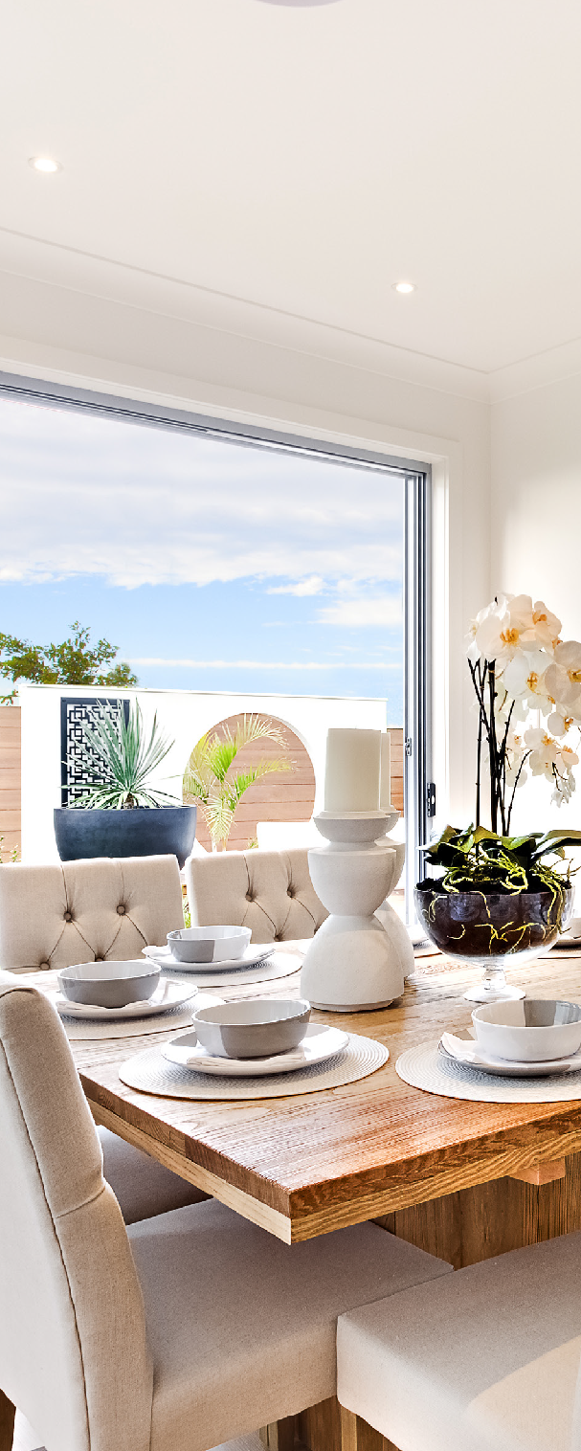
THE OBJECTIVE
Our mutual objective is to sell your home:
^{For the highest possible price}
^{In the shortest amount of time}
^{With the most favorable terms}
Prior to implementing any marketing strategies,
it is critical to go through a process of discovery:
Determine the fair market value
Survey the current market conditions
Review and prepare your home for sale

Slide 24

LUXURY MARKETING FOR
YOUR HOME

Slide 25
MARKETING FOR
MAXIMUM EXPOSURE
TOGETHER WE WILL:
^{Prepare for the “Window}
^{of Opportunity”}
^{Leverage the attributes of}
^{your location}
Prepare and present your home ready for sale
Highlight your home’s features through professional photography
Showcase your home to the market through professional and strategic marketing
Maximize the exposure of your home through our extensive network
Leverage the brokerage’s reputation and recognition
Cooperate and communicate to maintain your home’s perception of value
Cooperate and communicate to maintain your home’s perception of value
Promote your home locally, nationally, and internationally
Maximize your home’s web exposure
Prepare your home so that it is always ready to be shown to potential buyers
Discuss and review the market’s analysis of your home
^{Finalize your sale}
^{Find your next dream home}

Slide 26
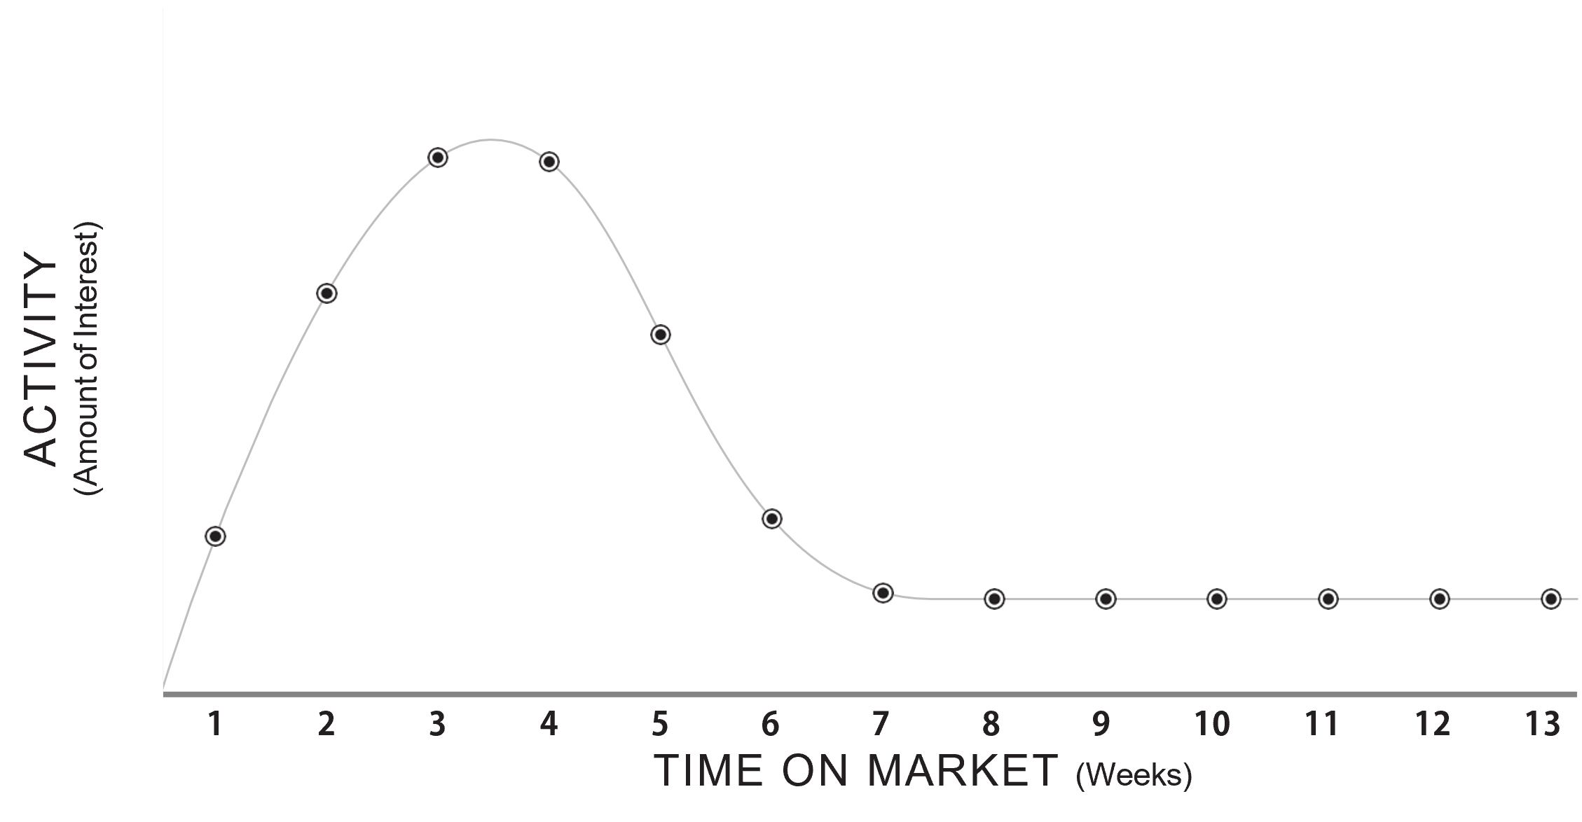
THE WINDOW OF
OPPORTUNITY
MAKING THE MOST OF INITIAL INTEREST
The “Window of Opportunity” is the period in which your home will receive its maximum exposure — typically when it is new on the market.

Slide 27

MARKETING YOUR
LOCATION
The 3 most important criteria to consider when buying a property are LOCATION, LOCATION, LOCATION.
In fact, buyers are often attracted to a general location, a neighborhood, or even a certain street well before settling on a specific home.
Understanding your location’s positives and negatives are important when determining price, and very significant in the marketing of your home

Slide 28

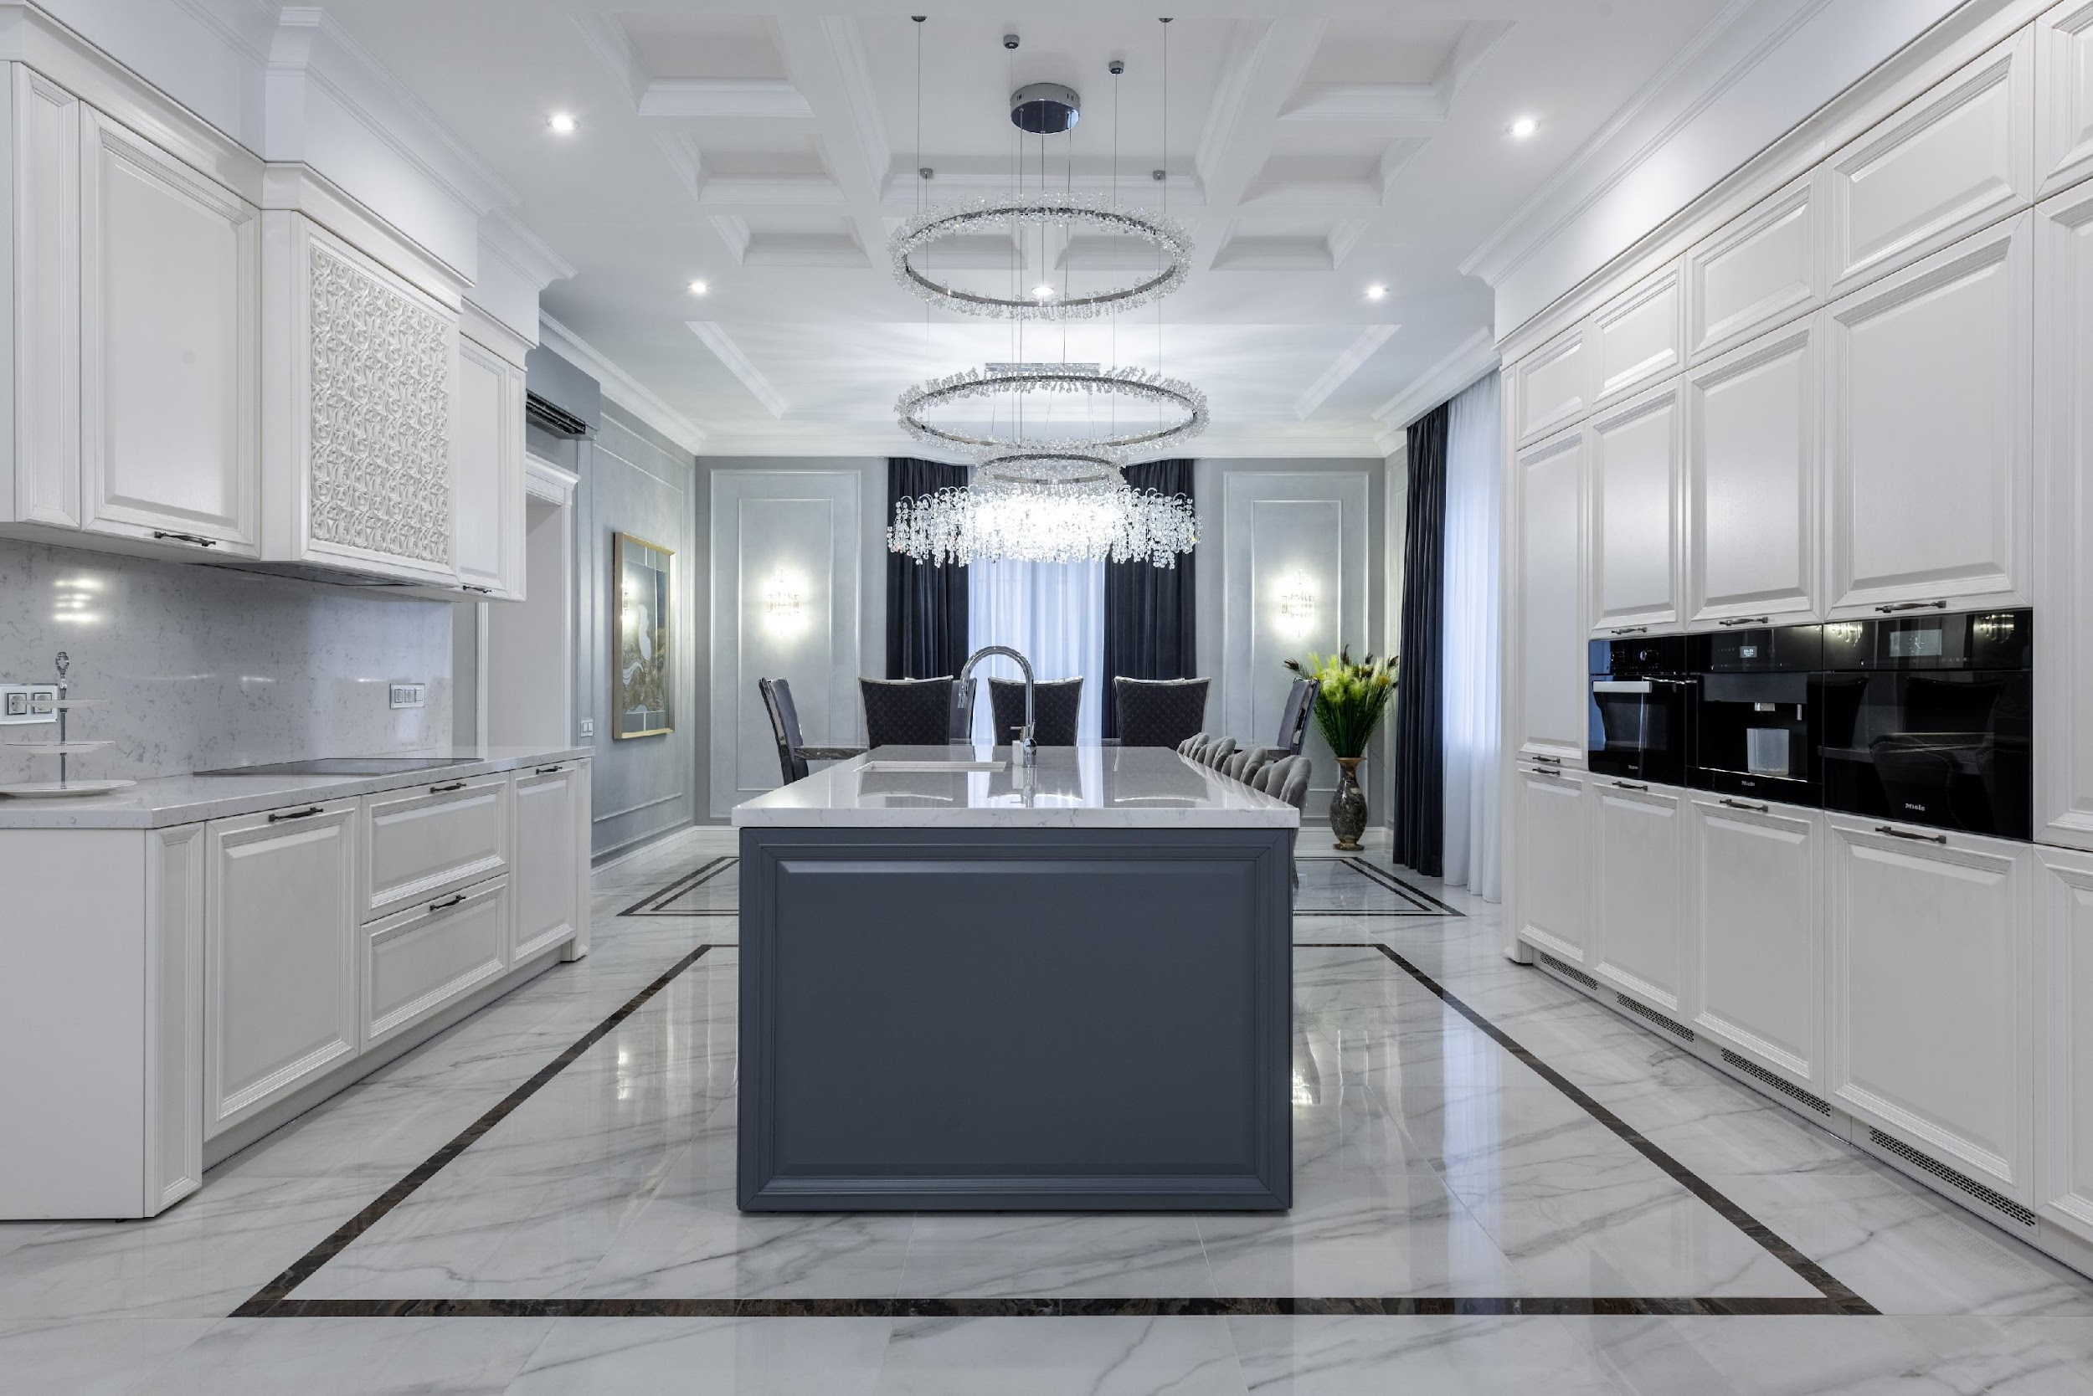
PREPARE TO PRESENT
YOUR HOME
^{PROFESSIONAL PHOTOGRAPHY}
Whether in print or on the web, photos are often the first impression a potential buyer will receive. A fully prepared home that is clean, tidy, with clear sightlines, and shot in its best natural light will speak volumes to potential buyers.

Slide 29


PREPARE TO PRESENT
YOUR HOME
^{DIGITAL TOOLS}
Using current technology helps showcase the true essence of the property and its environment. Lifestyle videos, 3D virtual tours, and aerial drone footage all provide a realistic depiction of the intended space and livability.

Slide 30
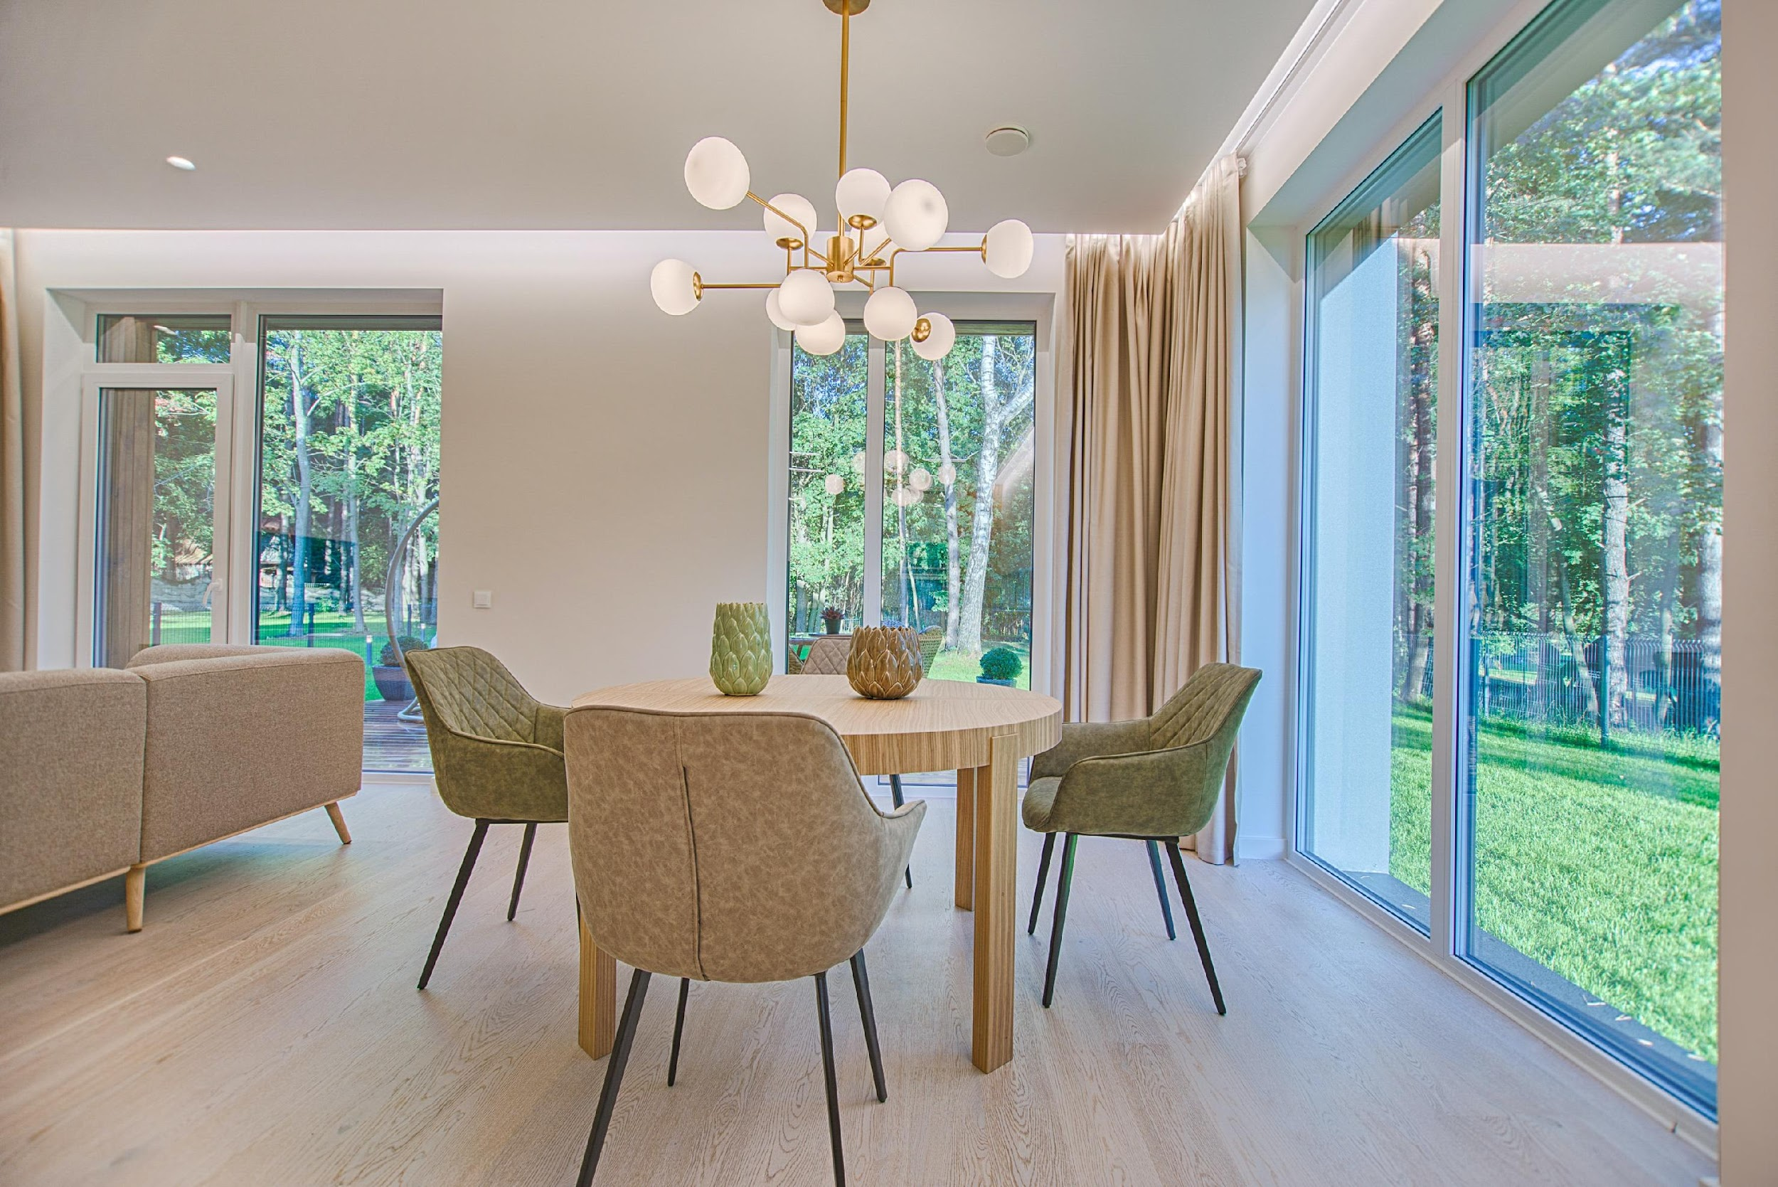
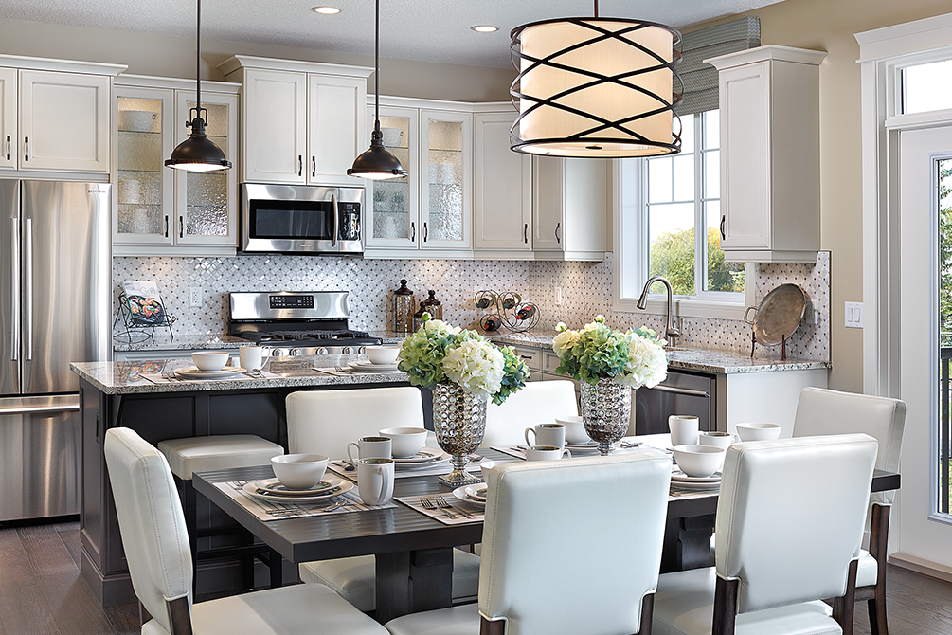
PREPARE TO PRESENT
YOUR HOME
^{HOME STAGING}
According to The National Association of REALTORS®, 83% of buyers’ agents say that staging makes it easier for buyers to ‘visualize’ the property as their future home, and 44% say it increases the dollar value offered. Additionally, 53% of sellers’ agents say that staging a home decreases the amount of time a home spends on the market.

Slide 31
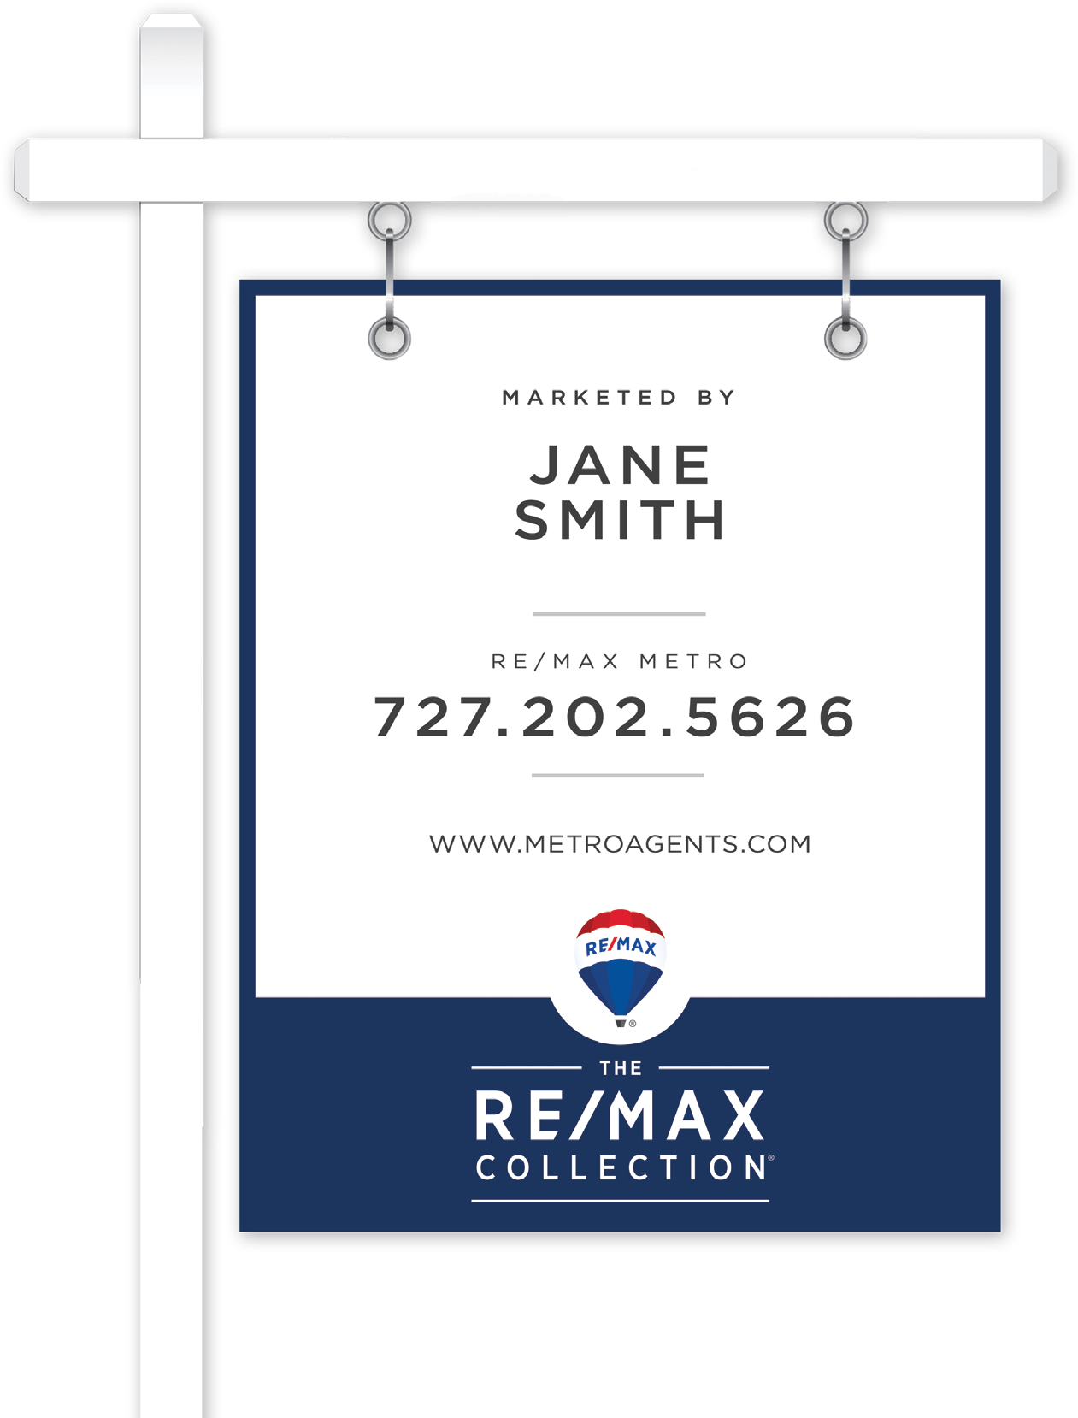
PROFESSIONAL AND
STRATEGIC MARKETING
^{SIGNAGE}
The trusted yard sign is the #1 way to show your home is for sale. It’s fast, effective, and easy to spot. Directional signs help guide people to the home.

Slide 32

^{PUBLIC AND PRIVATE SHOWINGS}
Broker tours and open houses are ways that other agents see your home and recommend it to their potential buyers. Real estate agents are particular, so ensure your home is well prepared.

Slide 33

^{PRINT ADVERTISING}
Luxury homes need exposure to elite clientele. Your home will be showcased to these affluent buyers through publications such as The Wall Street Journal, Unique Homes, DuPont Registry, Ocean Homes, The RE/MAX Collection Magazine, and James Edition.

Slide 34

^{NETWORKING & REFERRALS}
Real estate agents have a large database at their disposal, especially their networks with other agents. Referrals are especially important in the luxury market, as you will want to work with a well-respected agent with an extensive network of contacts.

Slide 35
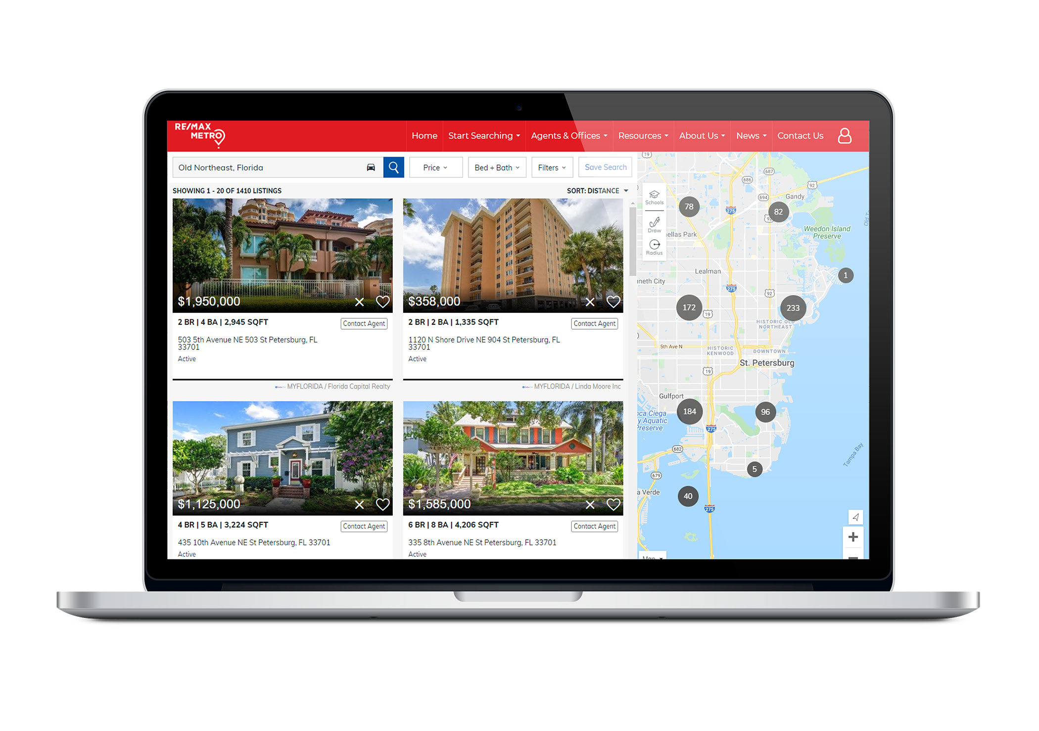
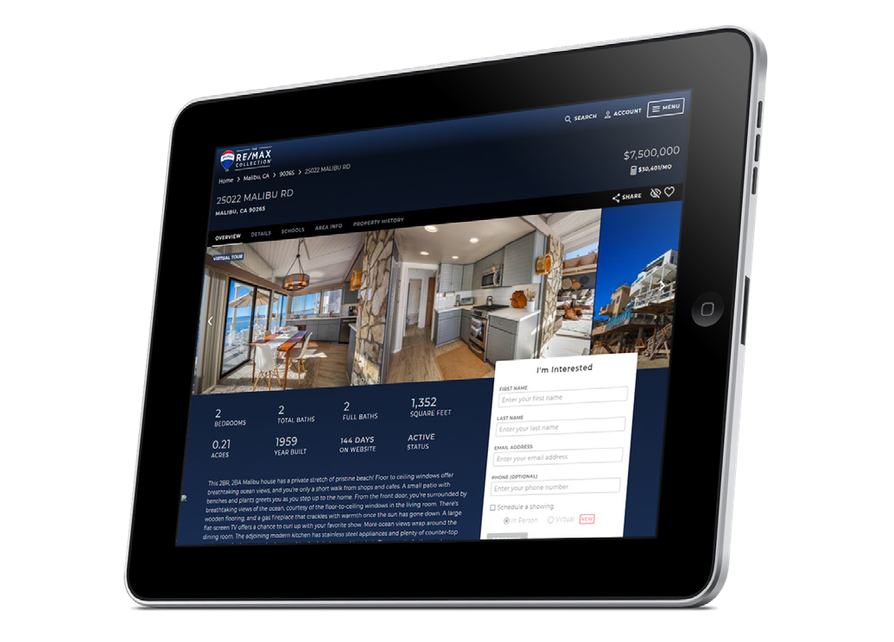
^{WEB EXPOSURE}
95% of buyers view homes online when starting their home search. Posting your home on the web increases its exposure locally, nationally, and internationally via any mobile device.

Slide 36



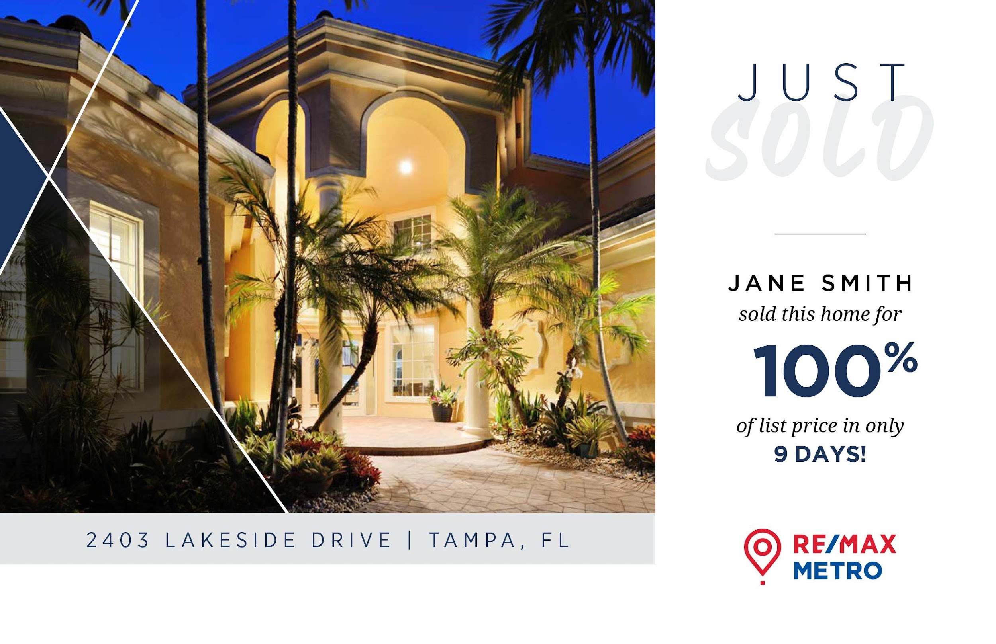

PROFESSIONAL PRINTING
AND DIRECT MAIL
Set your home apart from the competition with professional photography and sophisticated marketing materials. Mailing these to neighbors, potential buyers, and other Realtors is one of the most powerful ways to spread the message that your home is for sale.

Slide 37



















24/7 WEB EXPOSURE
As part of my marketing plan, your home will receive unparalleled exposure to consumers and Realtors across the globe through my extensive online partnerships.

Slide 38

SHOWING THE HOME
Your home always needs to be ‘show ready’
^{Remove unnecessary items}
^{Create space}
Implement a plan for the best times
^{to show the home}
^{Add inviting touches}
Every buyer will be pre-qualified
A fully guided tour will be provided to ensure that the features and nuances are showcased and explained to maximize the perception of value

Slide 39

MARKET ANALYSIS
My market analysis report is compiled from a system that tracks your showings, all Realtor and buyer feedback, as well as my marketing effectiveness on your home.
This report provides you with an in-depth analysis and a comprehensive list of actions, recommendations, and objectives.

Slide 40
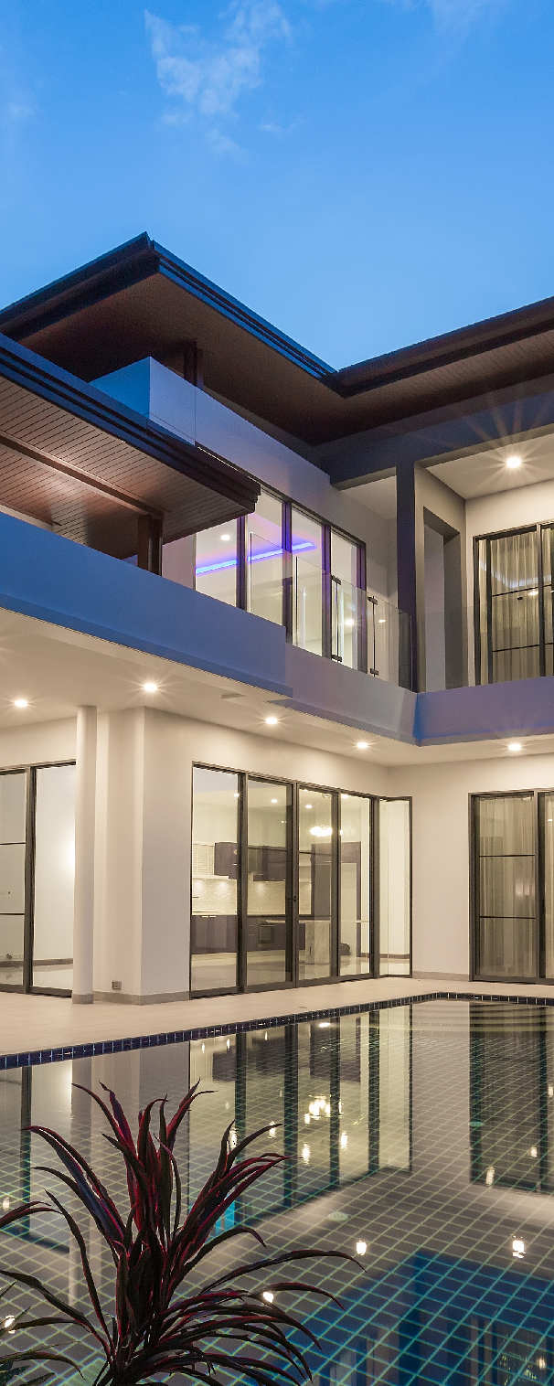
FINALIZING THE SALE
A myriad of details must be attended to before the sale becomes final, including offers, counter offers, inspections, disclosures, contingencies, loan documents, insurance, mortgage approval, and escrow items. This final step can be overwhelming with all its moving parts.
I am here to guide you through this final process — to keep in constant communication, track the proceeding, and keep things on schedule.

Slide 41

T H E S E A R C H F O R Y O U R N E X T
DREAM HOME

Slide 42
LOCATING THE RIGHT
PROPERTY
When looking to buy or sell another property, let my knowledge of your requirements, needs, likes, and dislikes be the foundation of a new search — from finding the perfect buyer to locating your next perfect dream home.
Allow my extensive network of connections, strong marketing skills, and exceptional knowledge open the right doors.
EXCLUSIVE
LUXURY
NETWORKS
STRATEGIC
ONLINE SEARCH TECHNOLOGY
INSIDE LOCAL KNOWLEDGE & CONNECTIONS
SUPERIOR
PROSPECTING CAPABILITIES

Slide 43
DEFINING YOUR GOALS
AND OPTIONS
Define your goals and requirements so that we approach the search with complete insight. This will enable the creation of an appropriate action plan and expected timeline.
Where are you thinking of moving — local or out of state?
^{Do you have a budget?}
What do you and your family need from your next home?
Are you looking for a turnkey or renovation property?
What are your essential requirements during our search?
Are there any financial considerations?
When is the ideal time for you to move?
It’s important to ensure that we research the true value of homes and that their current selling price reflects an amount that the property is “worth” to you

Slide 44

TRANSPARENT BIDDING WITH
OFFERSBYMETRO

Slide 45


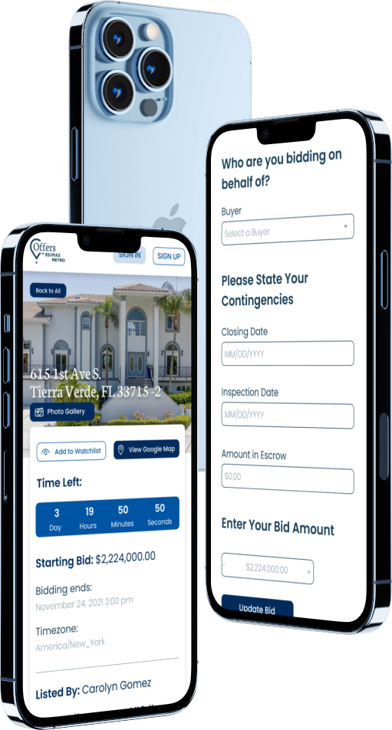
A MODERN SOLUTION
TO SELLING YOUR HOME
RE/MAX METRO’S TRANSPARENT BIDDING PLATFORM

Slide 46

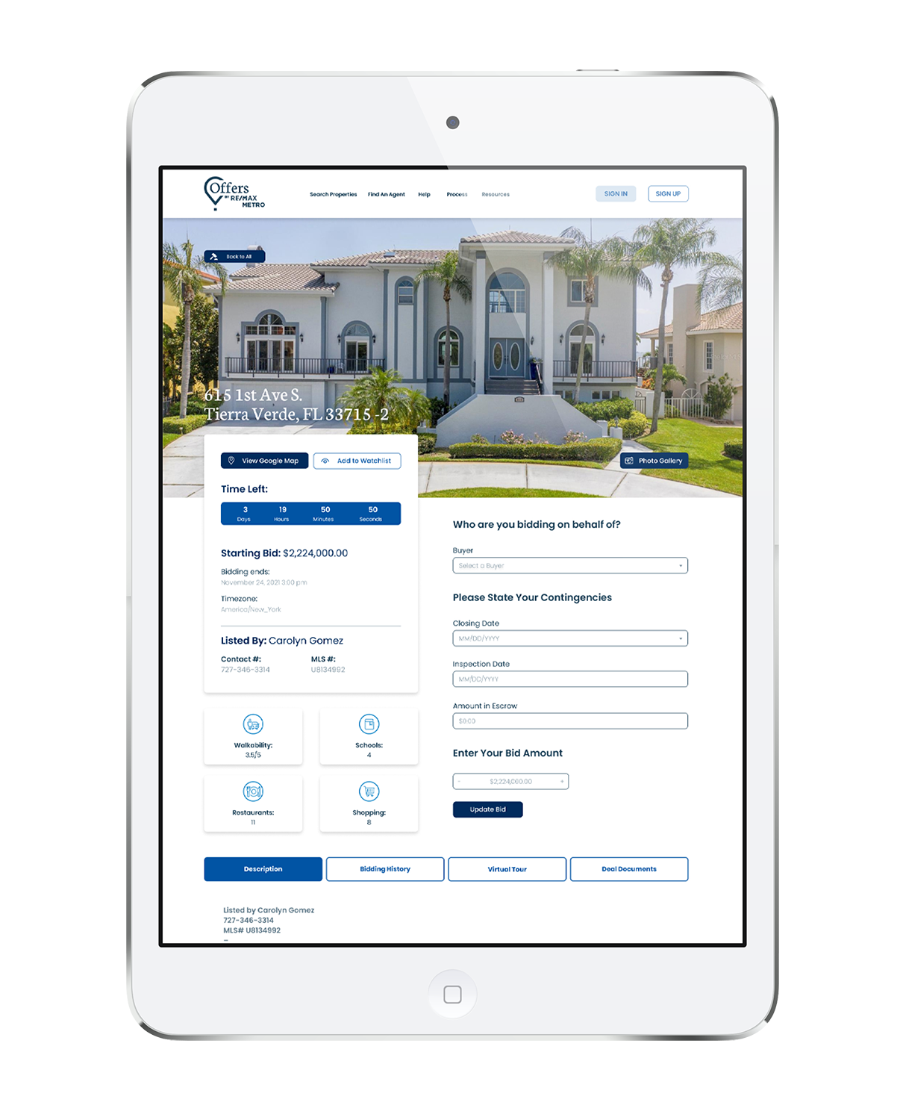
FOR BUYERS
Browse and bid on properties for sale in our area from your smartphone or computer

Slide 47
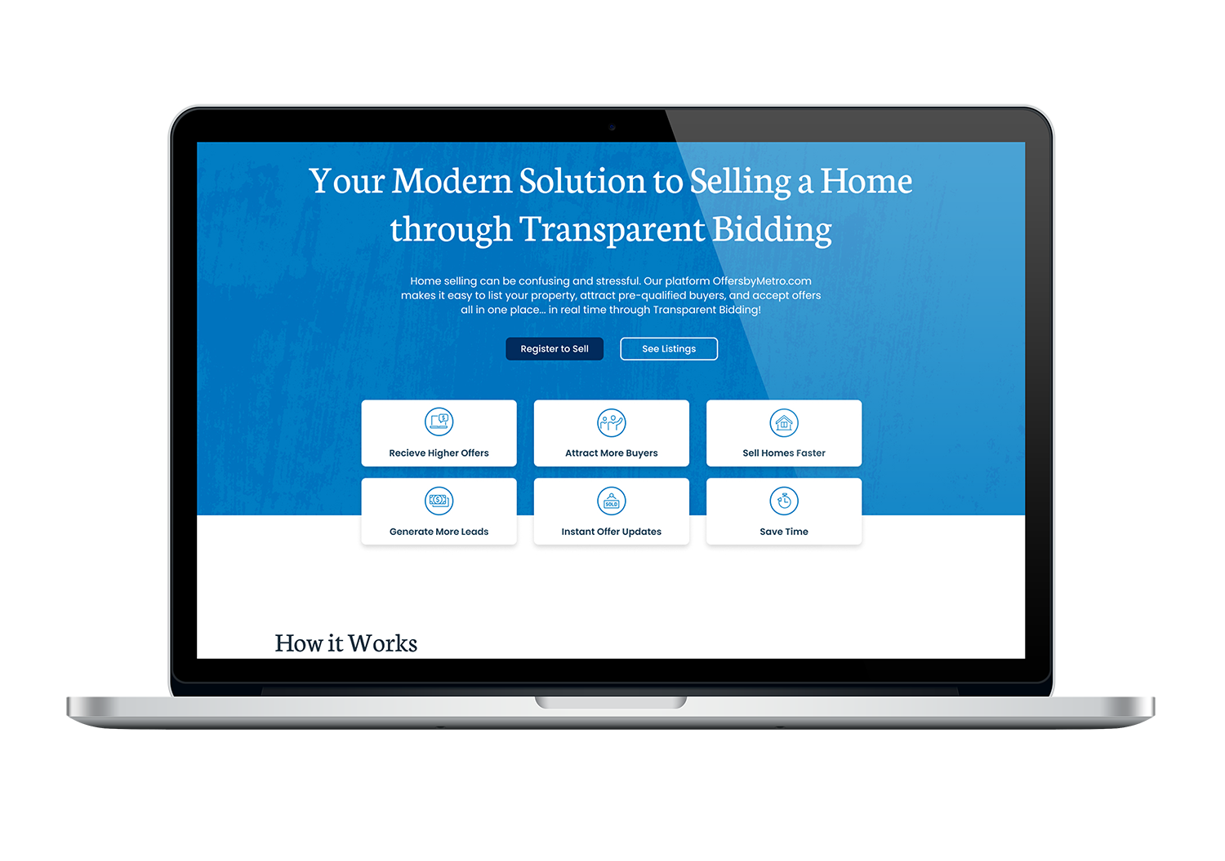
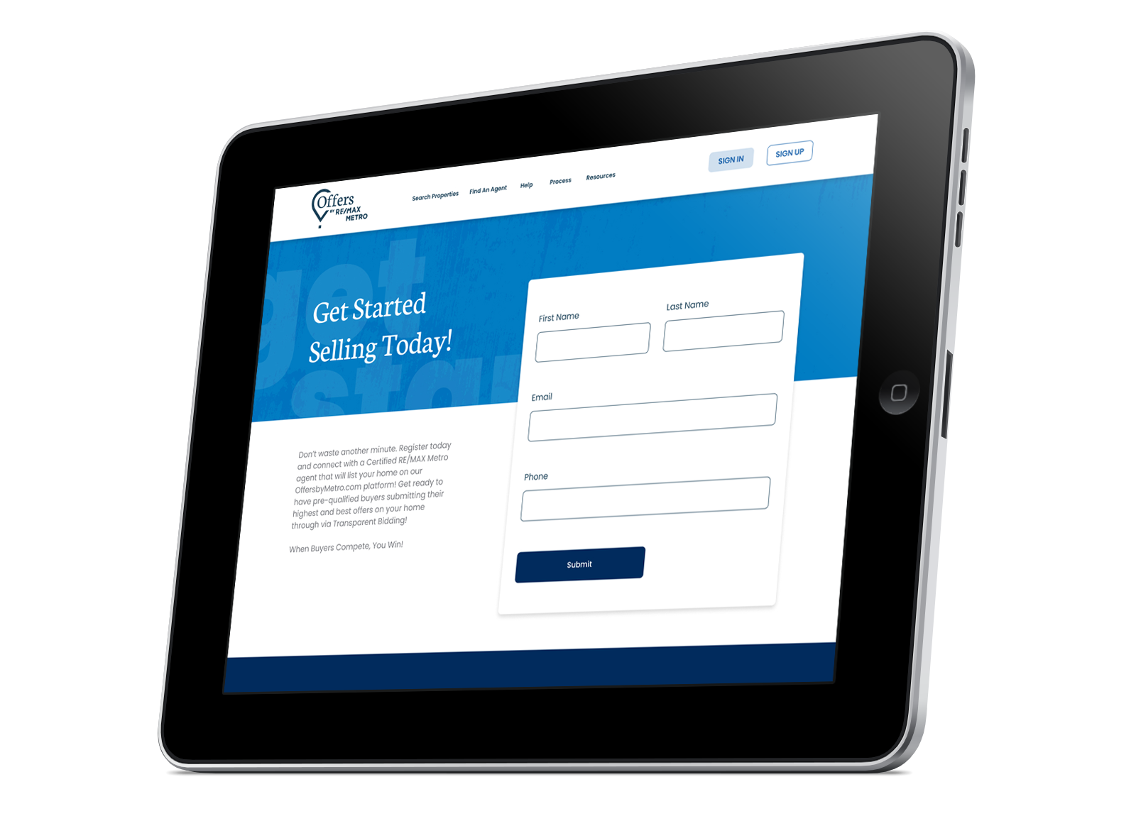
FOR SELLERS
^{List your property}
^{Attract pre-qualified buyers}
^{Accept offers}
^{Real-time online bidding}

Slide 48
MY COMMITMENT TO YOU
When helping you look for a property, I will make recommendations based on my experience and local knowledge, in addition to having access to a variety of technology, a wide network of area agents, and homes not yet on the market. A comparison chart and thorough, objective inspection of each home, combined with such factors as market data and resale potential, will help in narrowing your search. By building a checklist, we can better evaluate each home and review together the important criteria of homes visited.
And when you find that perfect home, I will help negotiate the best offer based on the condition of the home, length of time it’s been on the market, activity, location, and urgency of the seller. Ultimately, I will protect and represent your best interests.

Slide 49

THANK YOU

